Slide 1
Packages in Java
Abdul Haseeb

Slide 2
Package
Package is a collection of classes
Inside a Package class names must be unique

Slide 3
Declaration of Package
Package is defined using package keyword
package mypkg;
If we omit package statement classes are put into default package
All classes that we define in mypkg will be stored in a directory mypkg

Slide 4
Packages and Member Access
Packages are containers for classes
Classes are containers for code and data

Slide 5
Categories of Visibility for class members
Subclasses in same package
Non-Subclasses in same package
Subclasses in different package
Classes that are neither in same package nor subclasses

Slide 6
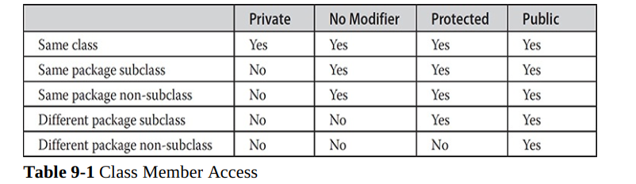
Class Member Access

Slide 7
Tasks
Create a Package p1

Slide 8
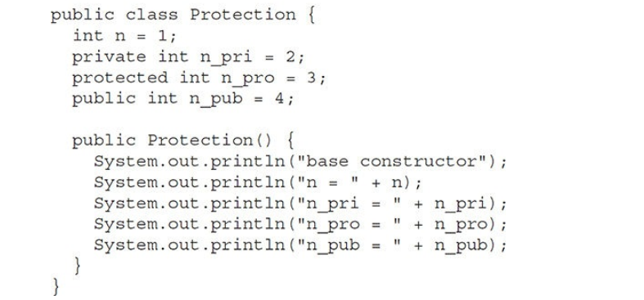
Tasks
Add a file named Protection.java

Slide 9
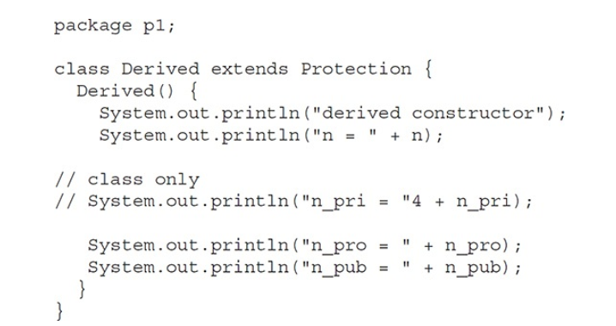
Tasks
Add a file named Derived.java

Slide 10
Tasks
Add a file named Derived.java

Slide 11
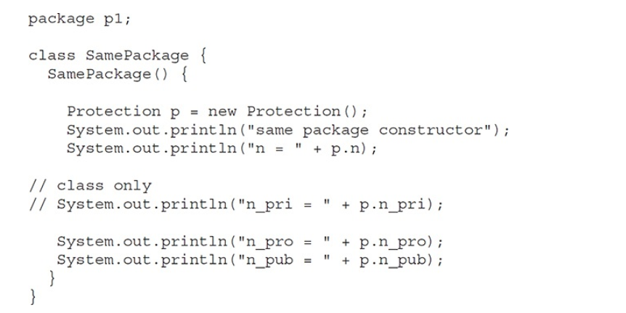
Tasks
Add a file SamePackage.java

Slide 12
Tasks
Create a package p2

Slide 13
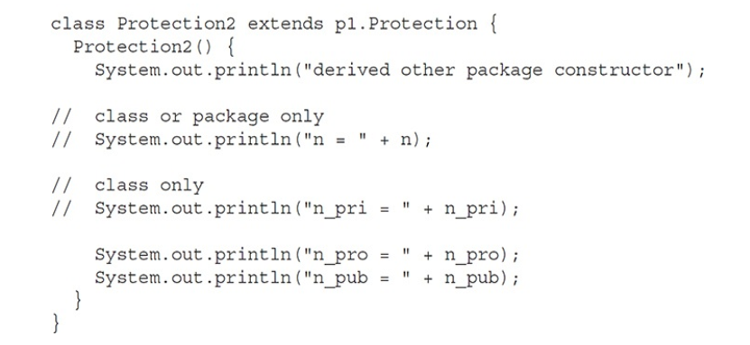
Tasks
Create a class Protection2.java

Slide 14
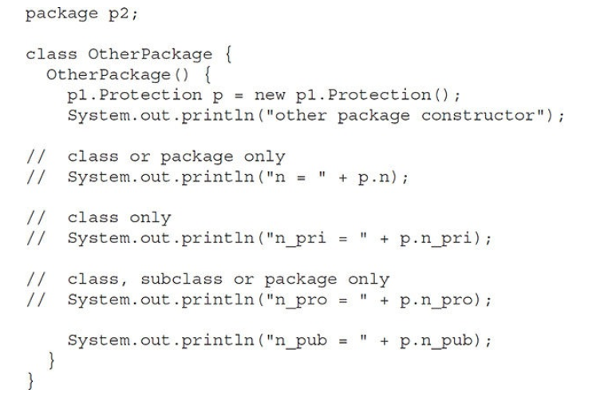
Tasks
Create a file OtherPackage.java

Slide 15
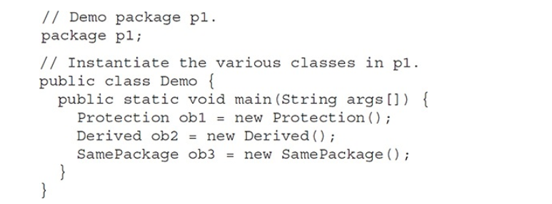
Create test classes for trying out packages

Slide 16
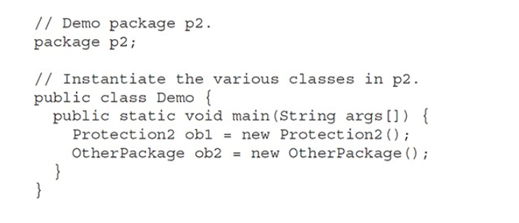
Create test classes for trying out packages

Slide 17
Importing Packages
import pkg1.pkg2.classname/*
pkg1 is top level package
pkg2 is sub-ordinate package
classname or * to import all classes in package

Slide 18
Java.lang
Most of language’s basic functions are stored in java.lang package
Compiler implicitly imports java.lang.*

Slide 19
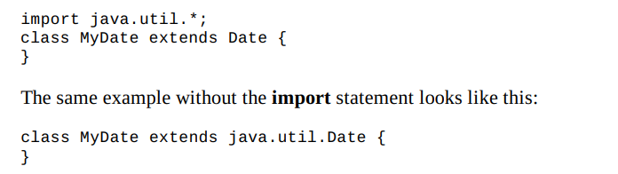
Import is optional, full qualified names can be used

Slide 20
Packages
After importing the package, only public members of that package will be visible to non-subclasses in the package

